Slide 1


COMPANY PROFILE
Supplier consumable & repairing, Office Factory Tool
Building Construction, Building Renovation, Maintenance & Metal Smith
PT. JAYA MUKTI TIGA SAUDARA
General Contractor & Supplier
Ruko Cortes, Jl.Dr. Cipto Mangun Kusumo Blok B22 No.10
Kel. Simpangan Kec. Cikarang Utara Kab.Bekasi
Telp: (021) 89329220 Fax : (021) 89329220 Email: jayamukti_3s@yahoo.com

Slide 2
Tentang Kami
PT JAYA MUKTI TIGA SAUDARA berdiri pada tanggal 3 April 2013, yang bergerak di bidang kontraktor umum dan supplier yang memberikan jasa pelaksanaan konstruksi bangunan.
Perusahaan kami mampu menangani proyek sejak awal , mulai dari tahap perencanaan hingga tahap pelaksanaan konstruk si dan berlanjut ke tahan maintenance.
Sebagai kontraktor , PT. JAYA MUKTI TIGA SAUDARA memegang tanggung jawab penuh dalam setiap proyek yang kami kerjakan.

Slide 3
Visi & Misi
VISI DAN MISI
Menjadi perusahaan kontruksi yang tangguh dan memiliki daya saing tinggi sehingga mampu terus tumbuh dan berkembang menjadi perusahaan kontruksi yang terkemuka di indonesia.
Menjadi perusahaan di bidang kontruksi yang penuh dedikasi, komitmen, tanggung jawab dan berkualitas bagi para pengguna jasa di seluruh Indonesia.
KOMITMEN
Menjadi rekan bisnis yang profesional, bertanggung jawab dan memiliki integritas. Serta memberikan produk kontruksi yang berkualitas berdasarkan acuan kontrak dan perundangan.
Melaksanakan proses yang terukur dan teruji serta menerapkan budaya K3L secara konsisten dalam upaya menghasilkan produk jasa kontruksi sehingga menbawa manfaat dan kepuasan bagi para konsumen / pengguna jasa.

Slide 4
Lisensi Perusahaan
Kartu Tanda Anggota ( Himpunan Jasa Kontruksi Indonesia )
Sertifikat Badan Pelaksana Jasa Kontruksi
Sertifikat Keahlian
Nomor Induk Berusaha No. 0220005270215
No. 503,09/2-0534/DPMPTSP/PM/VIII/2018.
5. Pengesahan Badan Hukum Perseroan
No. AHU-00300321.AH.01.02 TAHUN 2023
SBU (Kontruksi)
7. Surat Pengukuhan Perusahaan Kena Pajak
No. PEM – 01367/WPJ,22/KP,0203/2013
8. Nomor Pokok Wajib Pajak (NPWP) 31,733,908,3-413,000

Slide 5
Struktur Organisasi
DIRECTOR
PROJECT MANAGER
ADM & FINANCE
SAFETY OFFICER
CIVIL ENGINEER
QC / QS
ASS. ENGINEER
DRAFTER
LOGISTIC

Slide 6
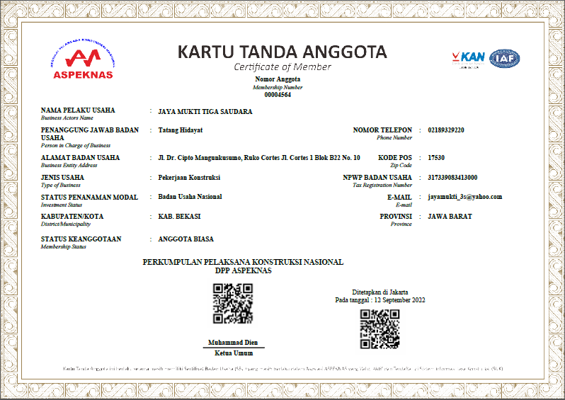

Data Perusahaan

Slide 7



Slide 8
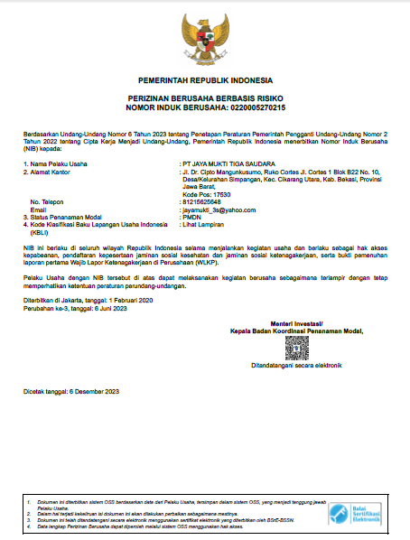
Data Perusahaan

Slide 9
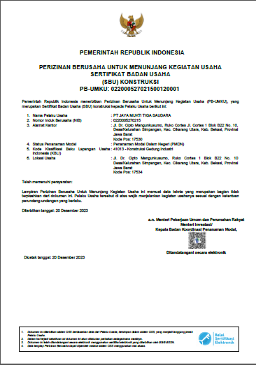
Data Perusahaan

Slide 10
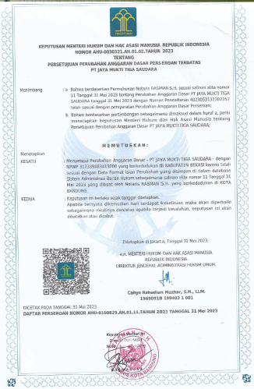
Data Perusahaan

Slide 11
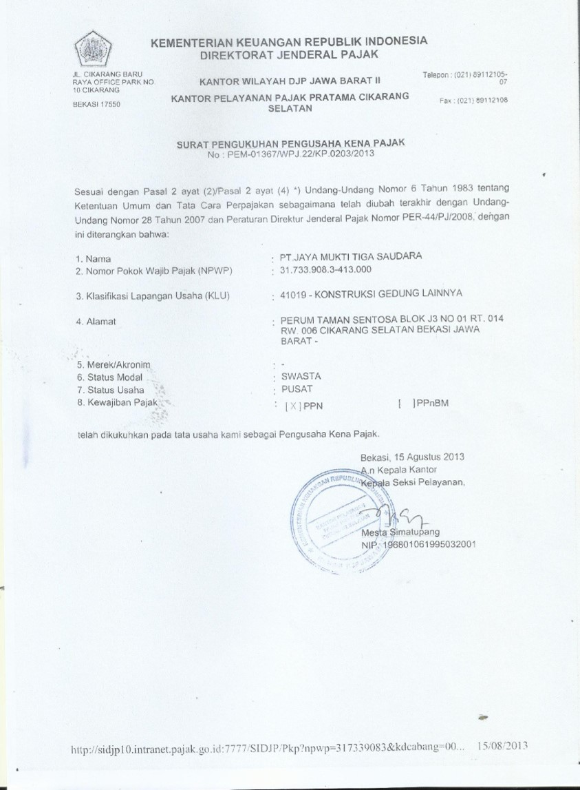
Data Perusahaan

Slide 12


Data Perusahaan

Slide 13
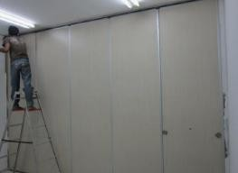
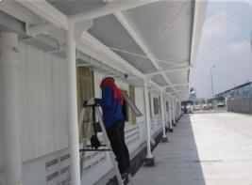
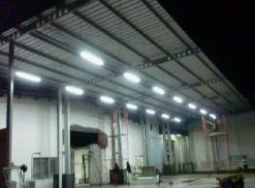
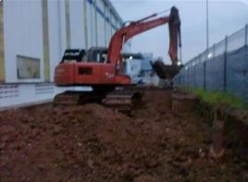
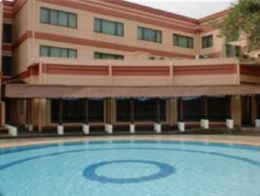
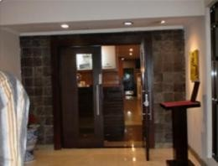
Dokumentasi Proyek
PT. AUTCOM PASI - MOVABLE PARTISI
PT. NAMICOH - CANOPY PARKING
PT. NAMICOH - CANOPY WORK
PT. NAMICOH - CONCRETE ROAD WORK
ASUKA RESTAURANT - EXPANSION BUILDING
ASUKA RESTAURANT - INTERIOR ENTRANCE

Slide 14
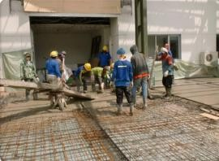
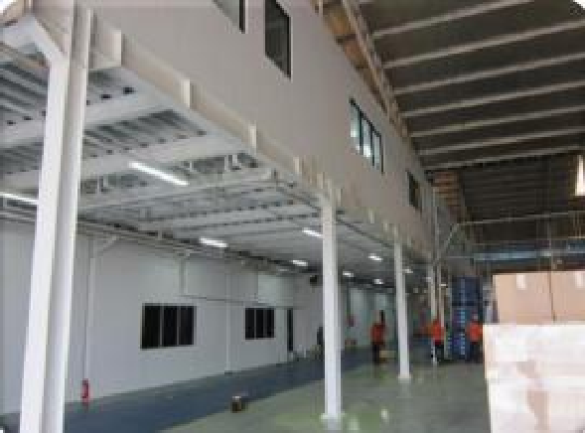
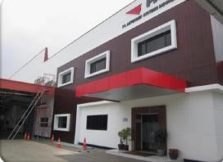
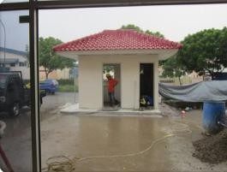
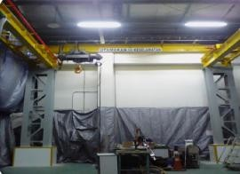
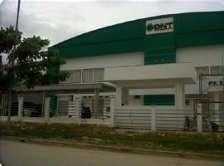
Dokumentasi Proyek
PT. NAMICOH - CONCRETE ROAD WORK
PT.AUTOCOMP PASI - ADD MEZZANINE
PT. AUTOCOMP PASI - RENOVATION FASADE
PT. KAKUICHI KASEI INDONESIA - POS SECURITY
PT. INDONESIA EPSON INDUSTRI
HOIST CRANE
PT. DNT INDONESIA
RENOVATION FACTORY

Slide 15
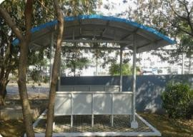
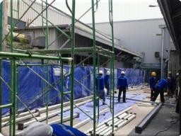
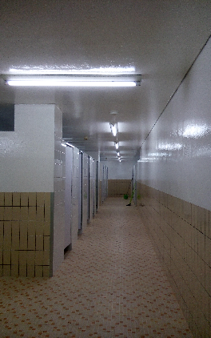
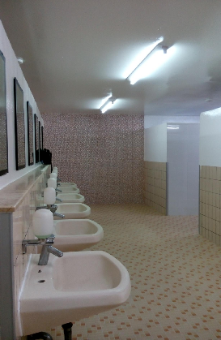
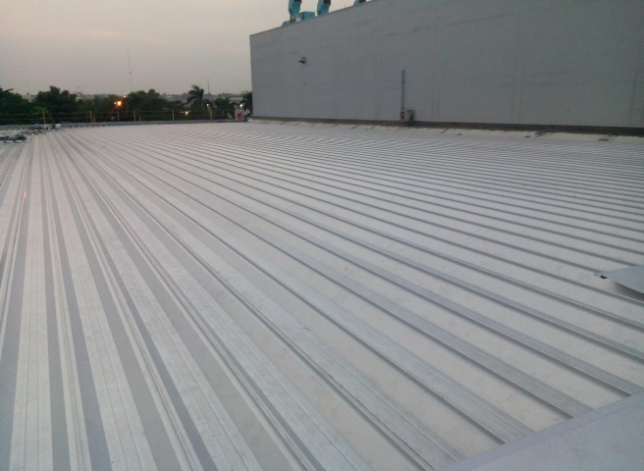
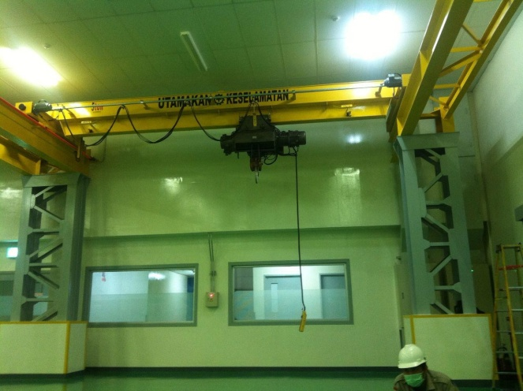
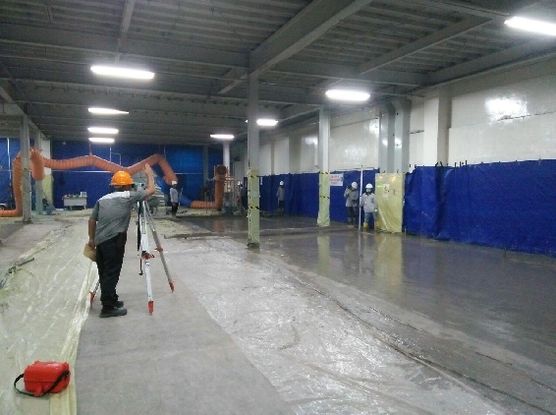
Dokumentasi Proyek
PT. INDONESIA EPSON INDUSTRI
SMOKING ROOM
PT. INDONESIA EPSON INDUSTRI
CANOPY WOR
PT. INDONESIA EPSON INDUSTRI
- RENOVATION TOILET IJP
PT. INDONESIA EPSON INDUSTRI
- CHANGE ROOF WORK
PT. INDONESIA EPSON INDUSTRI
- HOIST CRANE WORK
PT. INDONESIA EPSON INDUSTRI
- FLP REINFORCEMENT WORK

Slide 16
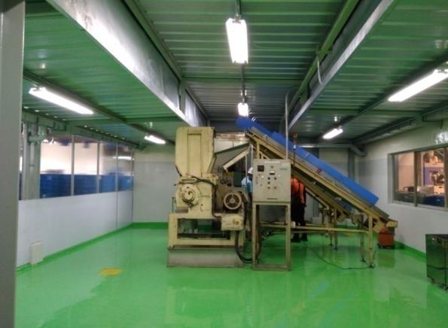
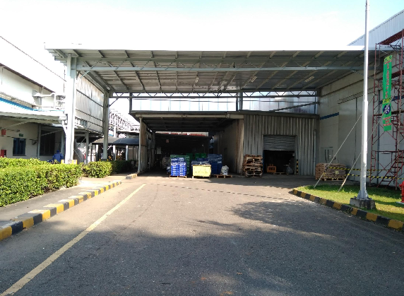
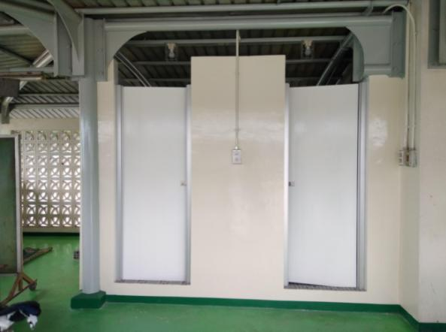
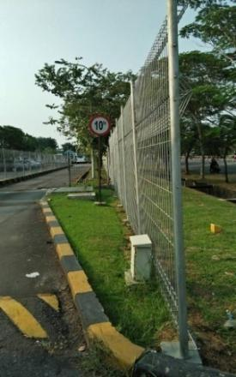
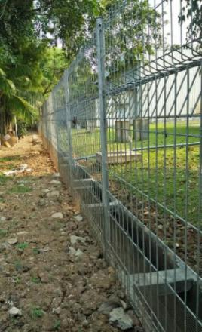
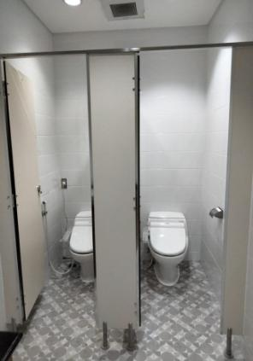
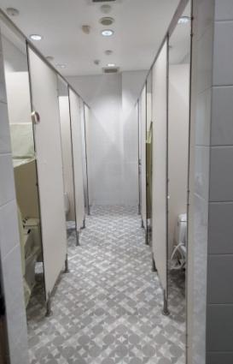
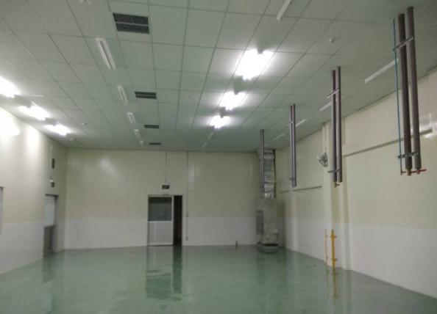
Dokumentasi Proyek
PT. INDONESIA EPSON INDUSTRI
- RELAYOUT CRUSHER ROOM
PT. INDONESIA EPSON INDUSTRI
- CANOPY MOLD E1
PT. INDONESIA EPSON INDUSTRI
- BICYCLE SHOWER
PT. INDONESIA EPSON INDUSTRI
- REPAIR BRC EXTERNAL
PT. INDONESIA EPSON INDUSTRI
- TOILET RENOVATION
PT. INDONESIA EPSON INDUSTRI
- INK RIBON PROJECT

Slide 17
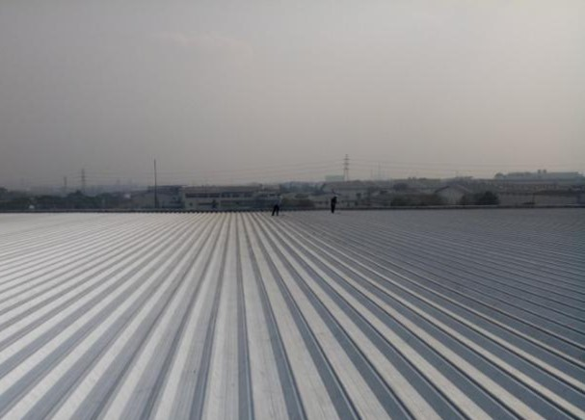
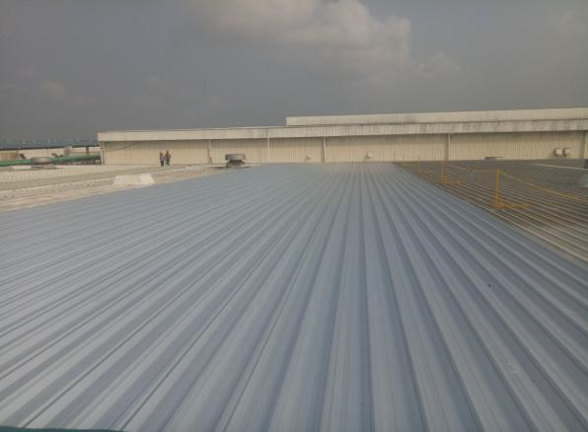
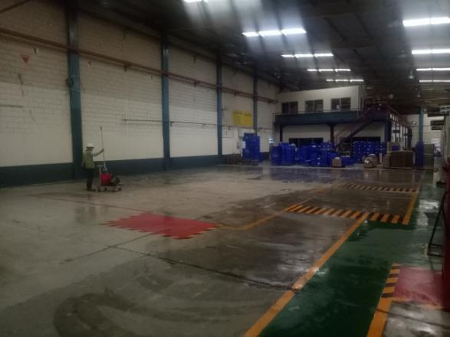
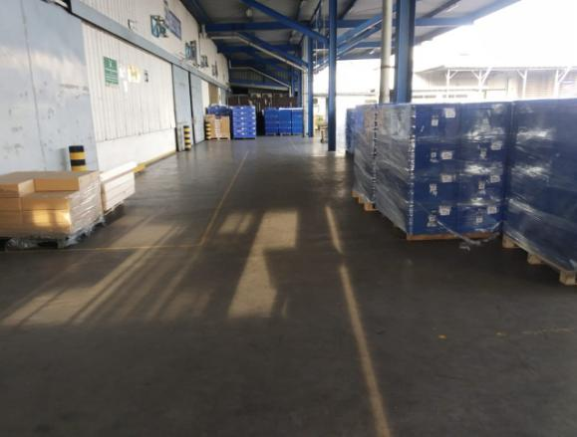
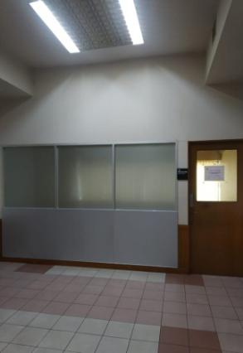
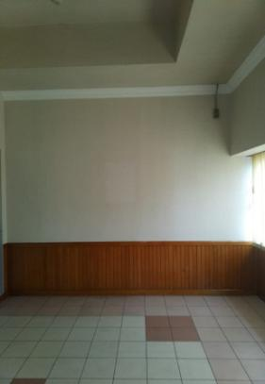
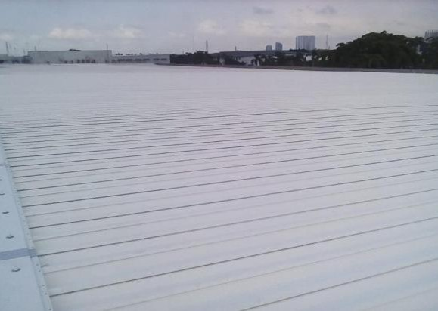
Dokumentasi Proyek
PT. INDONESIA EPSON INDUSTRI
- CHANGES ROOF E4
PT. INDONESIA EPSON INDUSTRI
- CHANGES ROOF PL E1
PT. MECOINDO
- DEMOLISHING MEIZZANINE
PT. INDONESIA EPSON INDUSTRI
- POLISHING FLOOR E2
PT. INDONESIA EPSON INDUSTRI
- MANAGER ROOM RENOVATION
PT. INDONESIA EPSON INDUSTRI
- E1 INSTALL NEW ROOF

Slide 18
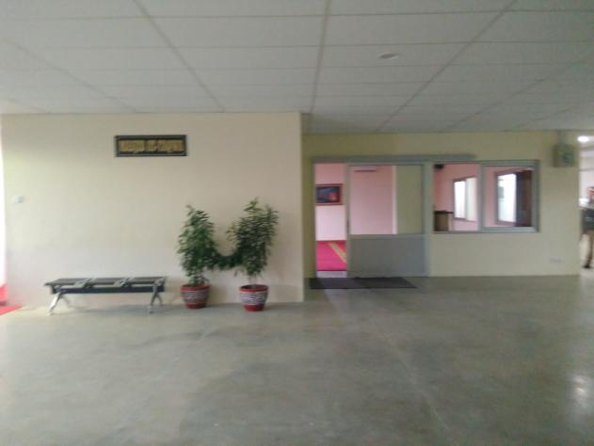
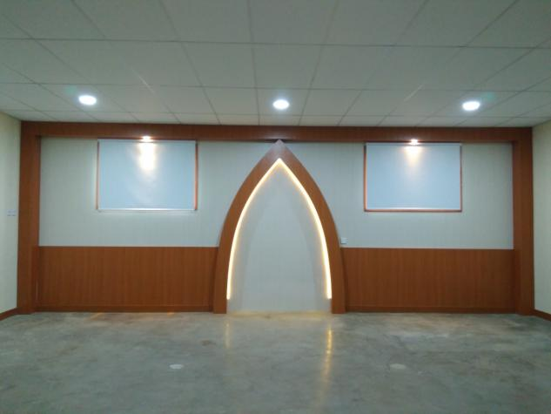
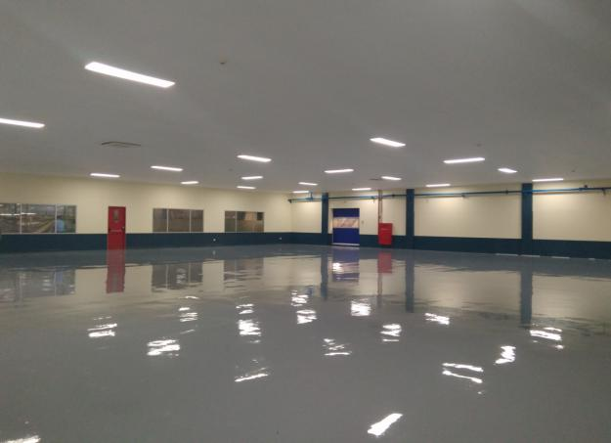
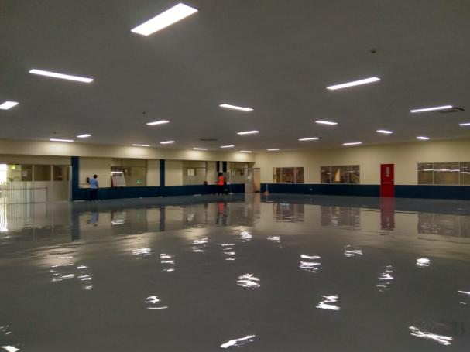
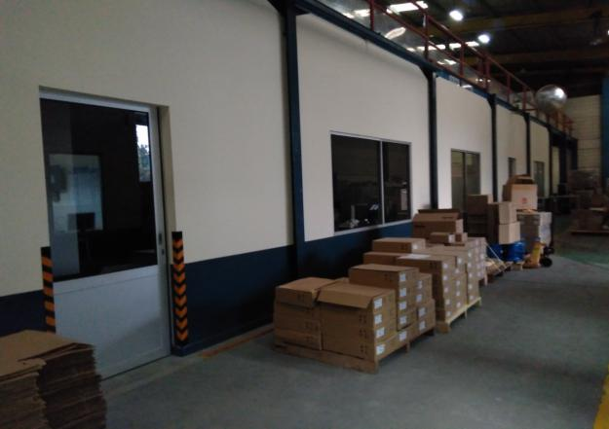
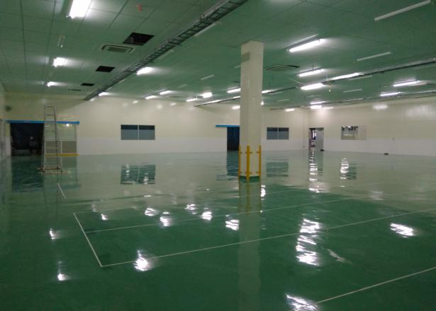
Dokumentasi Proyek
PT. MECOINDO - ITRON
RENOVATION PRAYROOM
PT. MECOINDO - ITRON
DESAIN INTERIOR PRAYROOM
PT. MECOINDO - ITRON
EXPANSION WAREHOUSE
PT. MECOINDO - ITRON
EXPANSION WAREHOUSE
PT. MECOINDO - ITRON
NEW SUSTAINING LAB ROOM
PT. INDONESIA EPSON INDUSTRI
- E4 NEW INK ASSEMBLY ROOM

Slide 19
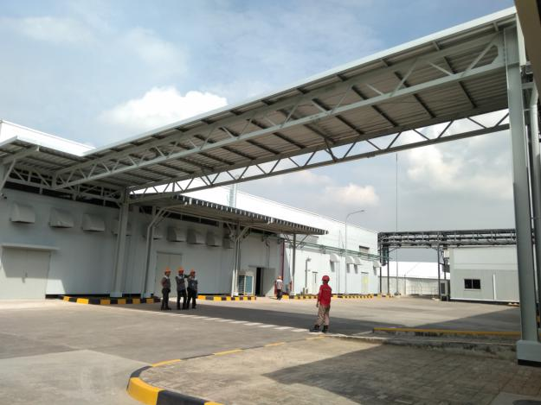
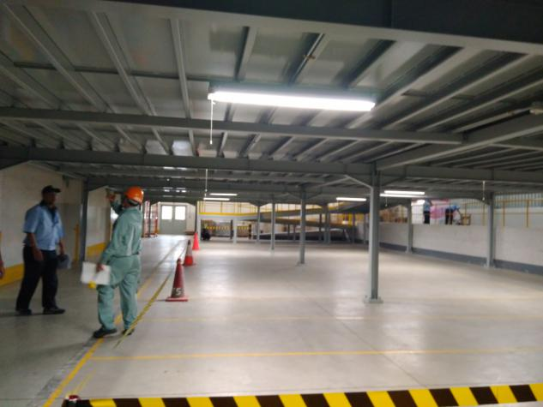
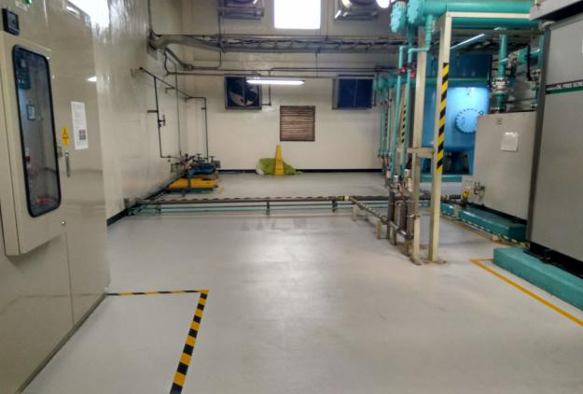
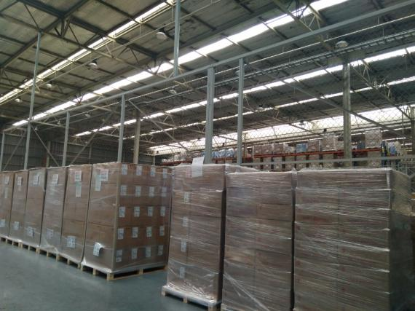
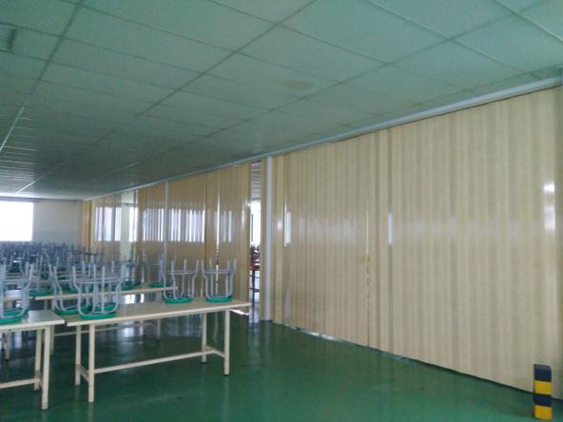

Dokumentasi Proyek
PT. INDONESIA EPSON INDUSTRI
NEW CANOPY EPSON 4
PT. INDONESIA EPSON INDUSTRI
NEW WH MEZZANINE EPSON 4
PT. INDONESIA EPSON INDUSTRI
SYNCOFLOOR EPSON 1
PT. INDONESIA EPSON INDUSTRI
HARMONICA PARTITION ILC
PT. INDONESIA EPSON INDUSTRI
NEW FOLDING PARTITION E4
PT. MECOINDO - ITRON
RENOVATION OFFICE

Slide 20









Dokumentasi Proyek
PT. INDONESIA EPSON INDUSTRI
RENOVATION TOILET MANAGER
PT. MECOINDO - ITRON
NEW STORAGE ROOM
PT. MECOINDO - ITRON
RENOVATION MALE TOILET
PT. MECOINDO - ITRON
RENOVATION FEMALE TOILET
PT. MECOINDO - ITRON
RENOVATION MALE TOILET STAFF
PT. MECOINDO - ITRON
NEW CONCRETE PARKING

Slide 21








Dokumentasi Proyek
PT. MECOINDO - ITRON
NEW MACHINE ROOM
PT. MECOINDO - ITRON
ADD NEW CONCRETE & CANOPY
PT. INDONESIA EPSON INDUSTRI
EXPANSION SMALL INJECTION
PT. INDONESIA EPSON INDUSTRI
REPAIR BRC FENCE WORK
PT. INDONESIA EPSON INDUSTRI
NEW CANOPY TRIBUN
PT. INDONESIA EPSON INDUSTRI
CHANGES ROOFING WORK E1

Slide 22








Dokumentasi Proyek
PT. INDONESIA EPSON INDUSTRI
NEW LOADING DOCK REC 1 E4
PT. INDONESIA EPSON INDUSTRI
NEW LOADING DOCK REC 2 E4
PT. INDONESIA EPSON INDUSTRI
NEW MEZZANINE E3 - E4
PT. INDONESIA EPSON INDUSTRI
SHEETMETAL ROOM E1
PT. INDONESIA EPSON INDUSTRI
RENOVATION JUMPSUIT PH E2
PT. INDONESIA EPSON INDUSTRI
PLASTIC PARTITION E3

Slide 23








Dokumentasi Proyek
PT. INDONESIA EPSON INDUSTRI
ANTISTATIC PARTITION WORK
PT. INDONESIA EPSON INDUSTRI
ADD ABLUTION ROOM E1
PT. INDONESIA EPSON INDUSTRI
PLASTIC PARTITION SMOKING
PT. INDONESIA EPSON INDUSTRI
PLASTIC PARTITION ABLUTION
PT. INDONESIA EPSON INDUSTRI
NEW ENGINEERING ROOM E2
PT. INDONESIA EPSON INDUSTRI
RENOVATION REST MANAGER

Slide 24








Dokumentasi Proyek
PT. INDONESIA EPSON INDUSTRI
NEW TABLE LIFTER E4
PT. INDONESIA EPSON INDUSTRI
NEW CANOPY CHEMICAL ROOM
PT. INDONESIA EPSON INDUSTRI
WAREHOUSE At BASKET BALL
PT. INDONESIA EPSON INDUSTRI
ADD NEW CANOPY ILC
PT. INDONESIA EPSON INDUSTRI
POLISHING FLOOR WORK
PT. INDONESIA EPSON INDUSTRI
RENOVATION SMALL INJECTION

Slide 25










Dokumentasi Proyek
PT. MURAMOTO ELEKTRONIK EPOXY FLOOR WORK
PT. MECOINDO - ITRON RETAINING WALL WORK
PT. MURAMOTO ELEKTRONIK CHANGES CEILING WORK
PT. INDONESIA EPSON INDUSTRI
ACRYLIC PARTITION WORK
PT. MURAMOTO ELEKTRONIK
NEW CONCRETE LOADING DOCK
PT. INDONESIA EPSON INDUSTRI
IMPRA BOARD PARTITION CANTEEN

Slide 26









Dokumentasi Proyek
PT. INDONESIA EPSON INDUSTRI
PLAT BORDES PROTECTOR
PT. INDONESIA EPSON INDUSTRI
ASPHALT FLOOR WORK E1
PT. TOYODENSO INDONESIA
NEW CANOPY WORK
PT. INDONESIA EPSON INDUSTRI
ADD NEW CANOPY BUS PARKING
PT. INDONESIA EPSON INDUSTRI
MODIFICATION BUS PARKING E4
PT. INDONESIA EPSON INDUSTRI
REPAIR BRC WORK E4

Slide 27











Dokumentasi Proyek
PT. MURAMOTO ELEKTRONIK NEW CANOPY LOADING DOCK
PT. MECOINDO - ITRON
NEW CONCRETE MOTOR CYCLE
PT. INDONESIA EPSON INDUSTRI
INSTALL VYNIL CURTAIN WORK
PT. INDONESIA EPSON INDUSTRI
NEW STAIR LIFT EPSON 3
PT. MURAMOTO ELEKTRONIK NEW TABLE LIFTER WORK
PT. MECOINDO - ITRON
DESAIN INTERIOR RELAX ROOM

Slide 28






Dokumentasi Proyek
PT. MURAMOTO ELEKTRONIK MEZZANINE WAREHOUSE
PT. MURAMOTO ELEKTRONIK MEZZANINE WAREHOUSE
PT. MURAMOTO ELEKTRONIK
REPAIR PAVING BLOCK
PT. MURAMOTO ELEKTRONIK
REPAIR FLOOR BY MORTAR
PT. MURAMOTO ELEKTRONIK REPAINTING WALL POS
PT. MURAMOTO ELEKTRONIK EPOXY FLOOR

Slide 29







Dokumentasi Proyek
PT. MURAMOTO ELEKTRONIK REPAIR DOWN PIPE
PT. MURAMOTO ELEKTRONIK INSTALL WIRE MESH NET
PT. MURAMOTO ELEKTRONIK
RELAYOUT PLASTIC PARTITION
PT. MURAMOTO ELEKTRONIK
SAFETY PROTECTOR
PT. MURAMOTO ELEKTRONIK HOIST CRANE
PT. MURAMOTO ELEKTRONIK INSTALL AIR COMPRESSOR PIPE

Slide 30






Dokumentasi Proyek
PT. RAYOVAC BATTERY
IINSTALL CARPET FLOOR
PT. RAYOVAC BATTERY
INSTALL HPL
PT. EPSON
CONCRETE BUS PARKING
PT. EPSON
CONCRETE BUS PARKING
PT. LOGISTEED Indonesia
INSTALL LOGGO
PT. LOGISTEED Indonesia
INSTALL LOGGO

Slide 31






Dokumentasi Proyek
PT. MECOINDO
LOGGO ITRON
PT. MECOINDO
LOGGO ITRON
PT. EPSON
REPAIR ROOLING DOOR
PT. OTICS INDONESIA
CHANGE ROOF PHASE 2
PT. OTICS INDONESIA
CHANGE ROOF PHASE 2
PT. OTICS INDONESIA
CHANGE ROOF PHASE 2

Slide 32






Dokumentasi Proyek
PT. OTICS INDONESIA
CHANGE ROOF PHASE 3
PT.OTICS INDONESIA
CHANGE ROOF PHASE 3
PT.OTICS INDONESIA
CHANGE ROOF PHASE 3
PT. OTICS INDONESIA
CHANGE ROOF PHASE 3
PT. OTICS INDONESIA
CHANGE ROOF PHASE 3
PT. OTICS INDONESIA
CHANGE ROOF PHASE 3

Slide 33
Daftar Klien
PT. ORBIT ENGINEERING
PT. INDONESIA EPSON INDUSTRY
PT. MURAMOTO ELEKTRONIKA INDONESIA
PT. TOYO DENSO INDONESIA
PT. TOYOPLASH INDONESIA
PT. PERSEK PENTA MURI AGUNG JOINT
PT. SUMMIT MAS AUTO
PT. MECOINDO / ITRON
PT. JAYA OBAYASHI
PT. MAURICHI
PT. NAKAMA TEKNIKA TRUSINDO
PT. NIPRO INDONESIA JAYA
PT DAIKO BUANA PRIMA
PT. NGK CERAMICS INDONESIA
PT. LOGISTEED INDONESIA
PT. SENAYAN TRIKARYA
PT. PLASINDO LESTARI
PT. KD HEAT TECHNOLOGY INDONESIA
PT. SBP INDONESIA
PT. SMCC
PT. SANWA SCREEN INDONESIA
PT. AUTOCOMP
PT. NUSA TOYO TETSU CORPORATION
PT. PT. OTICS INDONESIA
PT. TAIYO SINAR RAYA TEKNIK

Slide 34
TERIMA KASIH
PT. JAYA MUKTI TIGA SAUDARA
General Contractor & Supplier
Ruko Cortes, Jl.Dr. Cipto Mangun Kusumo Blok B22 No.10
Kel. Simpangan Kec. Cikarang Utara Kab.Bekasi
Telp: (021) 89329220 Fax : (021) 89329220 Email: jayamukti_3s@yahoo.com

